Slide 1
Life Processes 1.Atp 2.Breathing system
CHAPTER SIX -6.2

Slide 2
ATP
ATP is the energy currency for most cellular processes. The energy released during the process of respiration is used to make an ATP molecule from ADP and inorganic phosphate.
The Adenosine triphosphate (ATP) molecule is the nucleotide known in biochemistry as the "molecular currency" of intracellular energy transfer; that is, ATP is able to store and transport chemical energy within cells. ATP also plays an important role in the synthesis of nucleic acids.

Slide 3
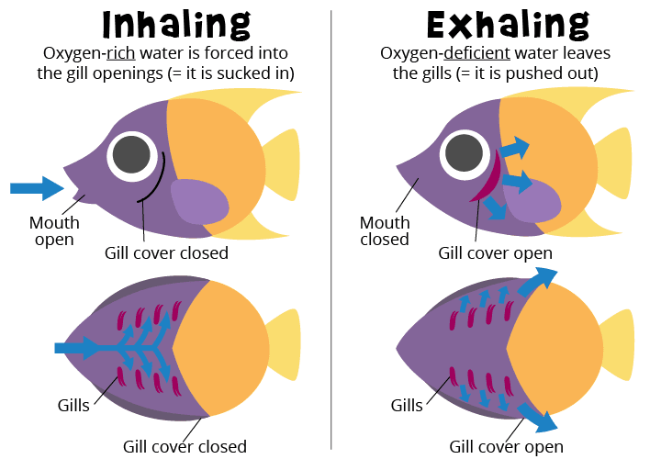
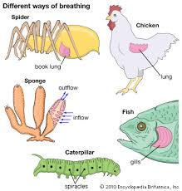
Animals breathing system
From air
In water
Notes:
Add video –breathing of animals(fish compulsory in video)

Slide 4
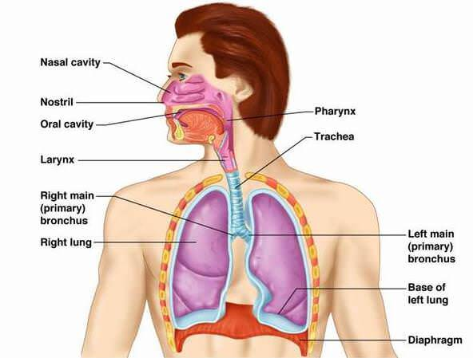
Human Breathing System
Notes:
Add video on human breathing system.

